Slide 1


GROUP: 03
STADIUM SEAT BOOKING MANAGEMENT SYSTEM
MEET SHELADIYA — 19BIT076
RENISH JAGANI — 19BIT108
RISHIT SAMARIYA — 19BIT109
RISHABH PATEL — 19BIT141
UJASH THAKKAR — 19BIT142
ANANAYA KHANDELWAL — 19BIT144

Slide 2

INTRODUCTION
The stadium serves as the center point for major events, especially sporting events such as cricket. It’s one thing to build a stadium and it’s quite another to run one. Ticket sales and management are an essential part of stadium operations. The system is also deemed crucial because its failure will result in substantial financial loss for the stadium's management business, as well as, for the viewers.
The seat booking system must be built using well-established software engineering principles that ensure a high level of reliability. The primary goal of this study is to develop a dependable and simple-to-use database system that will make buying tickets easier. A more reliable and modern entry system to the stadium, which will minimize costs on a match-by-match basis and provide a more equitable system for ticket distribution while monitoring seating space.
Through the implementation of a stadium ticket booking system, we will try to find solutions to the challenges that seat booking management faces. This research would transform the conventional system for managing tickets to an automated system in order to reduce problems for stadium staff.
Our system will facilitate precise statistics for each match, including the number of spectators in each match, Temperature of respective attendees, the revenues generated from the sales of tickets as well as other amenities such as jerseys and food.

Slide 3
PROJECT BENEFITS
In Stadium Seat Booking Management System we explored and learn many things like firstly we learn how to
collect the data for our required system and also learned how to generate data when necessary.
Then we learned about the database software in our case we used MySQL which an open-source relational database management system. In MySQL we explored how to create proper environment by following installation procedure then learnt how to create database schema and setting proper constraints and also how we can fetch data into MySQL software.
This project then further guided us by learning how DBMS can be used to remove problems of file system which happens in earlier times and different levels of abstraction like physical level, logical level, View level at initial stage then we created Relational and Entity Relational Model for our project. This Models has given us the outline to our project.
Then we understand about the query processing language and how to write and run queries in MySQL software by fetching our Stadium Seat Booking Management System’s data. After that we did normalization on our data tables by using normalization techniques and increase the quality of our data.
Synergy and fast communication with team members has led us to complete this project successfully.
This Project has benefitted us in all possible ways and we have gained many skills along with the journey.

Slide 4

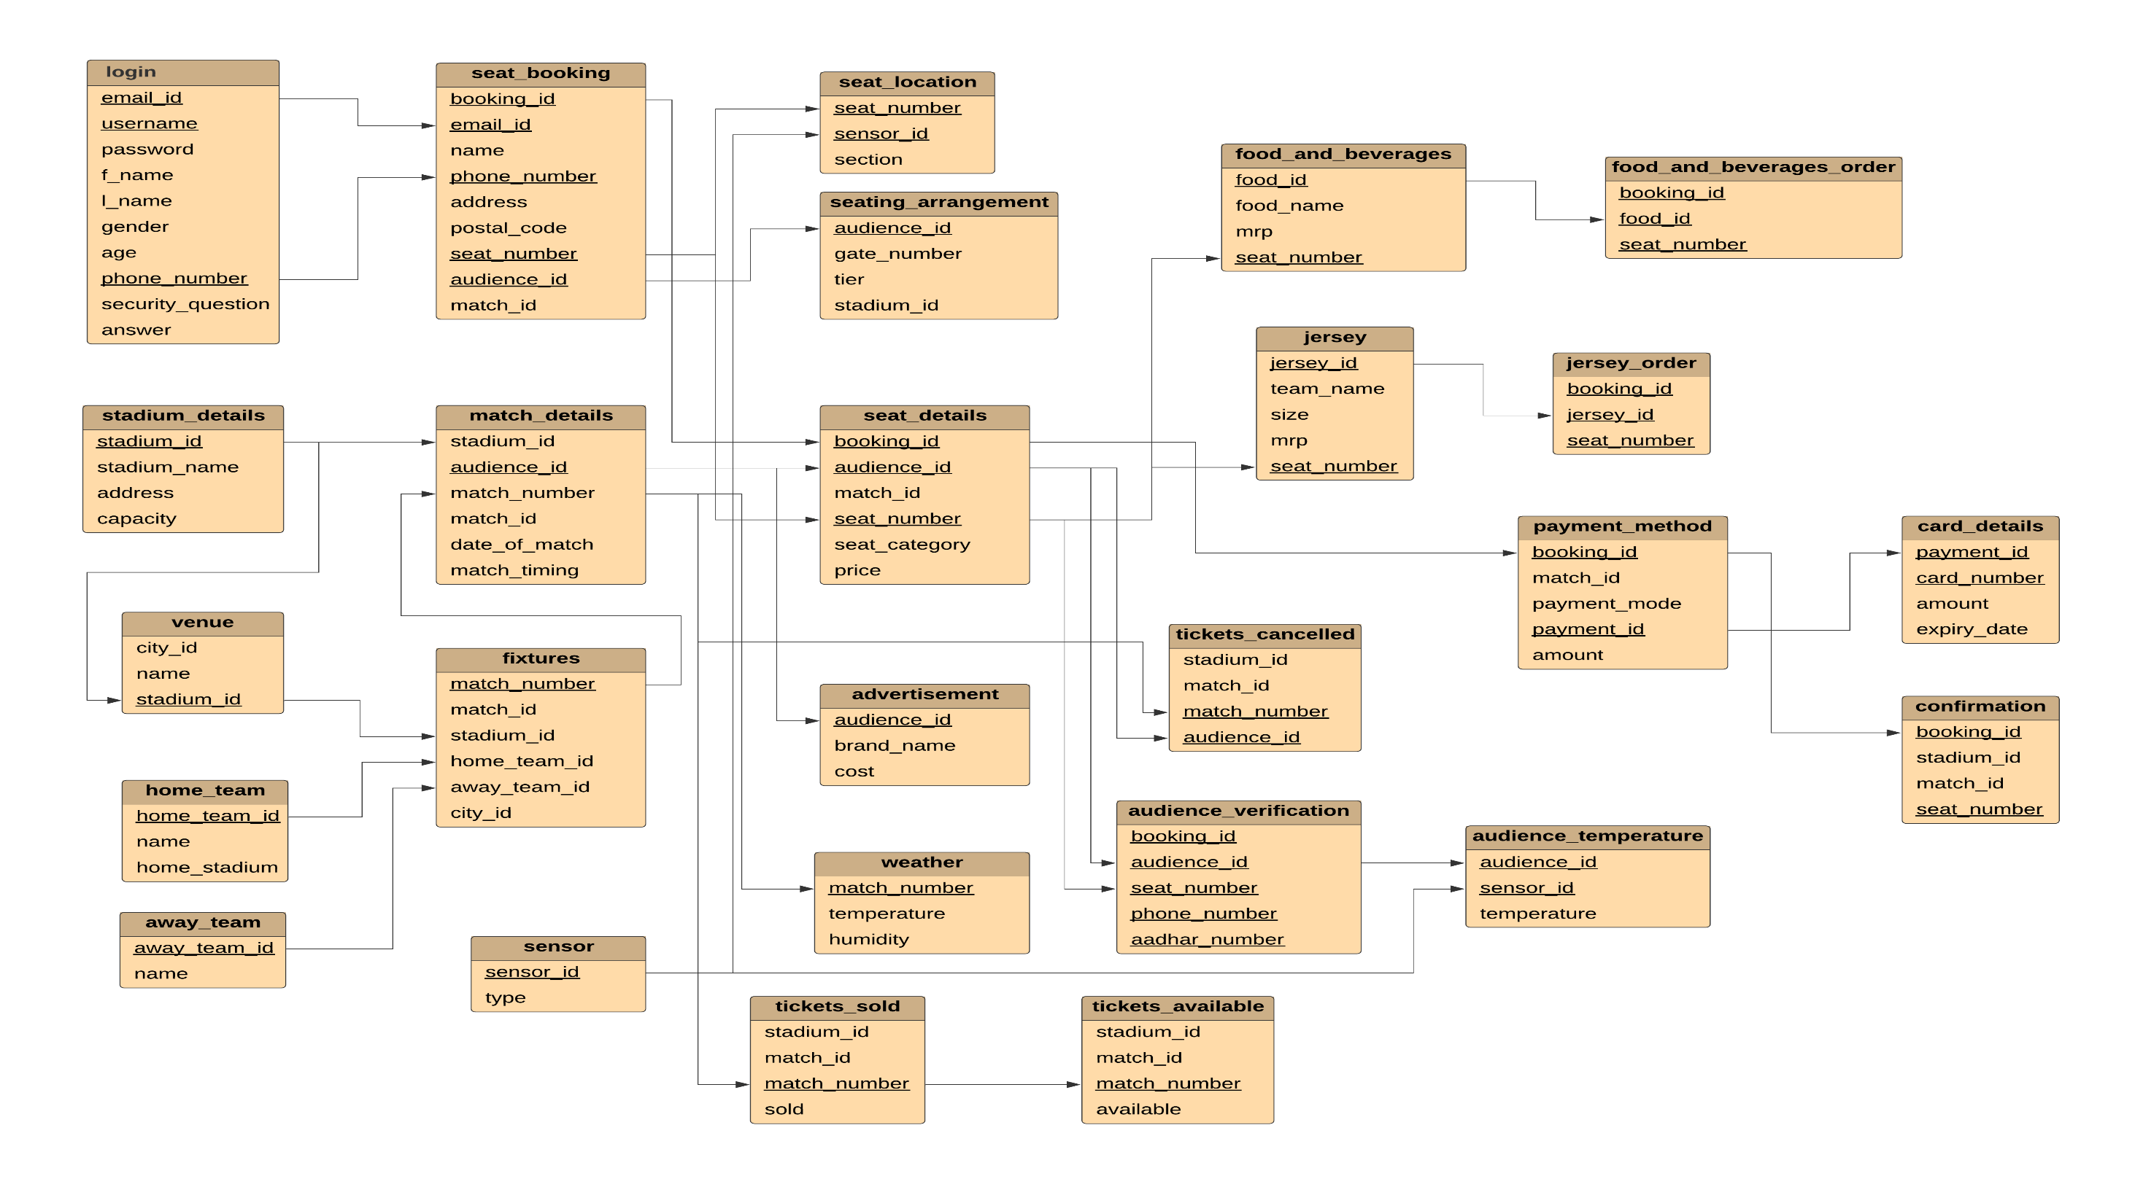
RELATIONAL MODEL

Slide 5
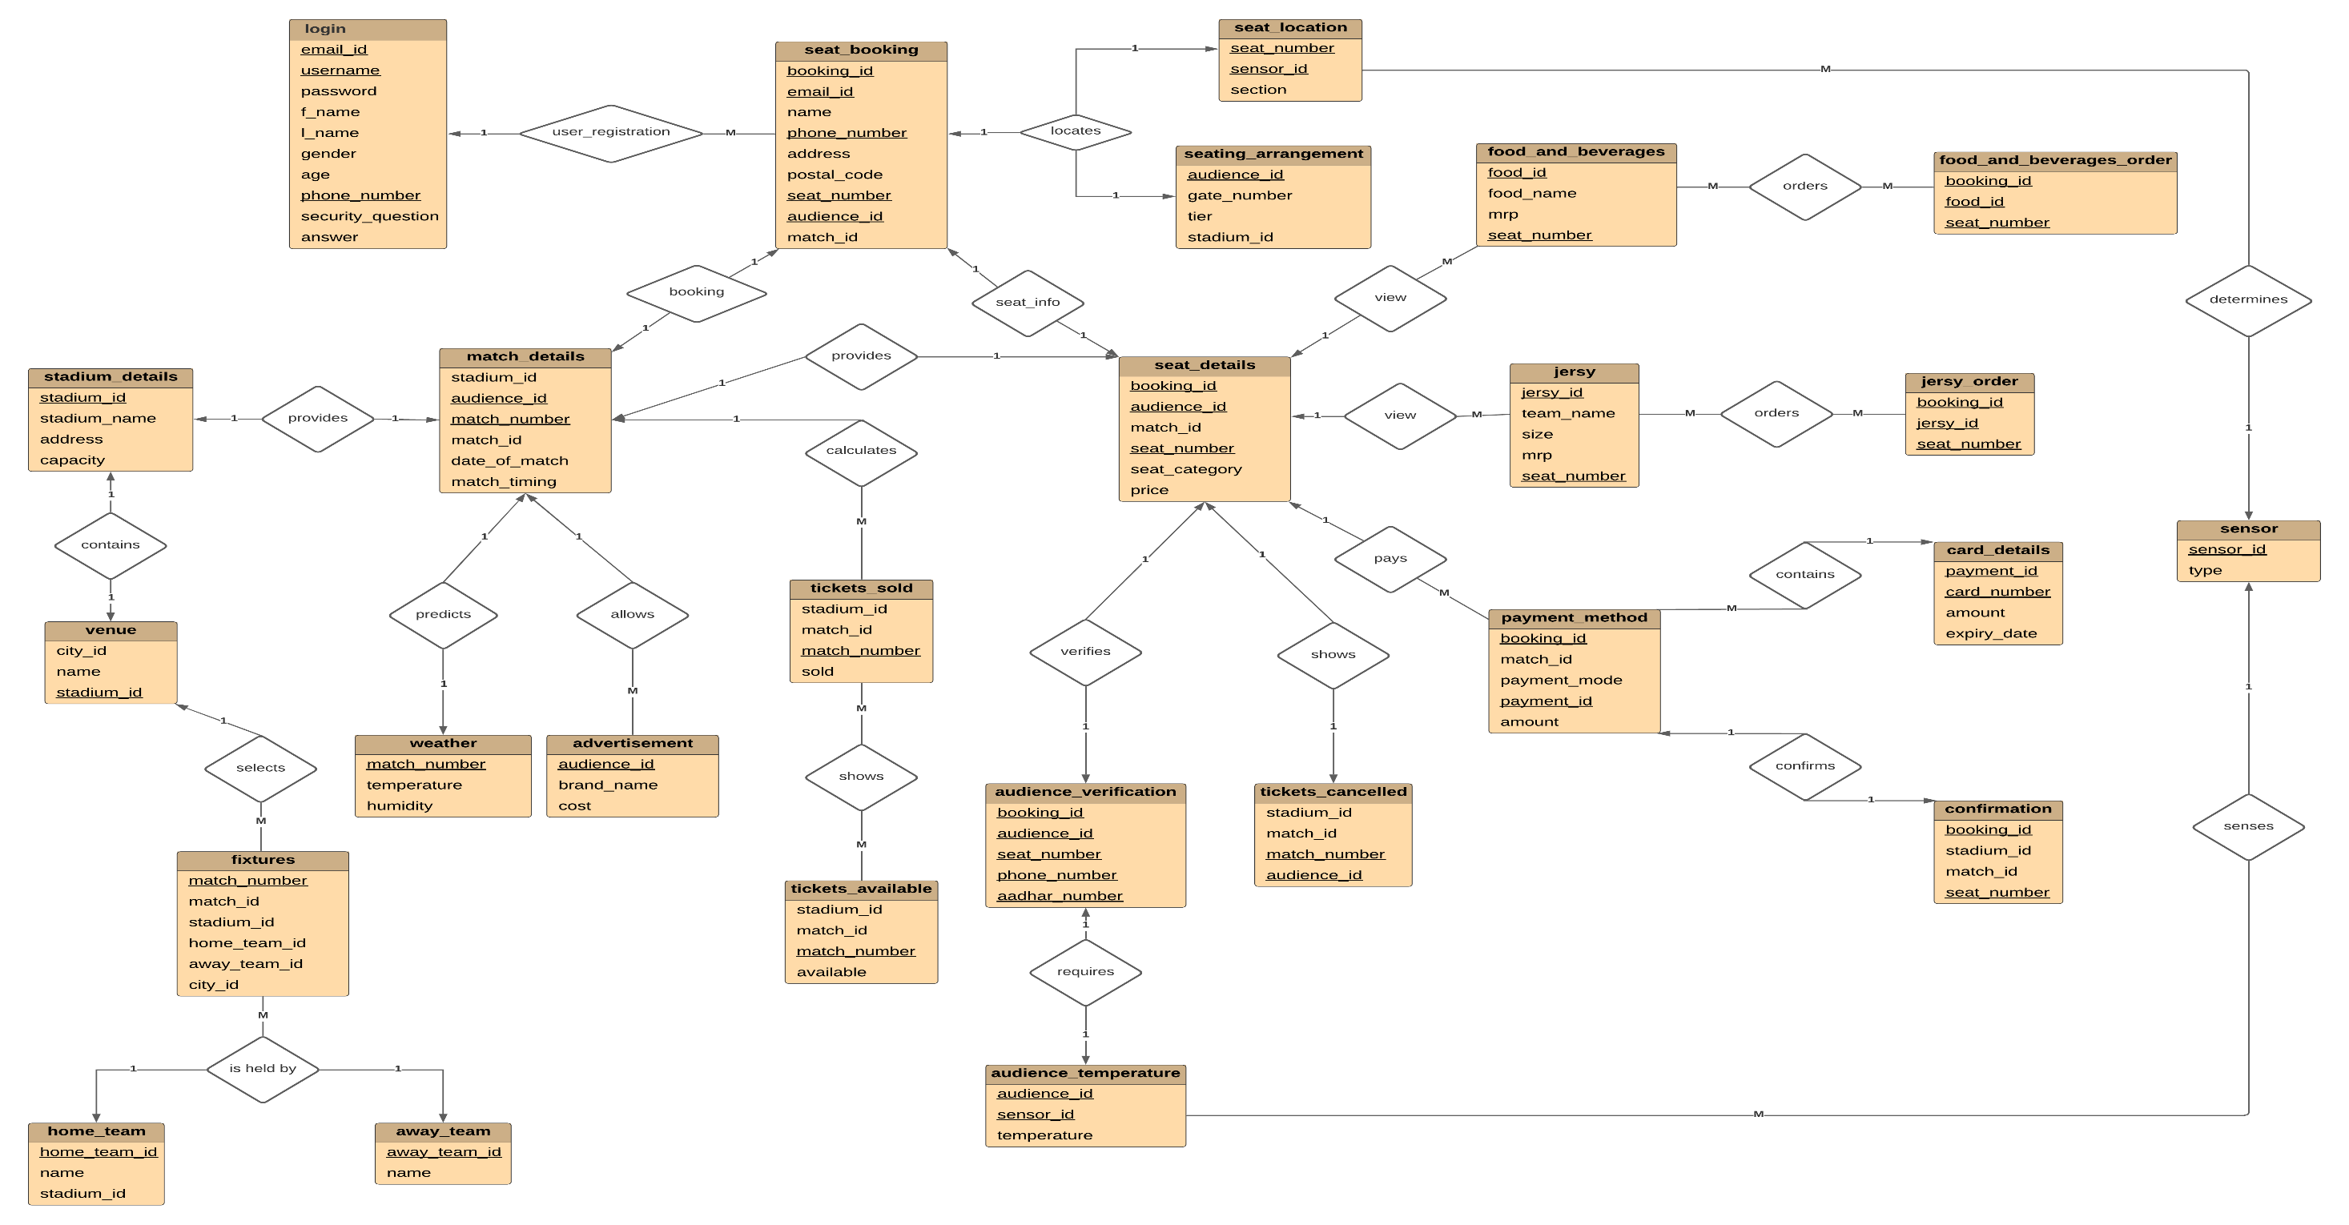
ER MODEL

Slide 6
EXPERIMENTAL ANALYSIS
 | Feature 1 | Feature 2 | Feature 3 | Feature 4 | Feature 5 | Feature 6
[Development of online ticket system at a football club] | No | Yes | No | No | No | No
[On-Line Football Tickets Reservation System] | Yes | No | No | No | No | No
[Mobile E-Ticketing Reservation System For Amman International Stadium In Jordan] | No | Yes | No | No | No | No
[Ticket Pricing in European Football – Analysis and Implications] | No | No | Yes | No | No | No
[Stadium Management Information System. A Case study Of Dan Anyiam Stadium Owerri Nigeria] | No | No | No | No | No | No
[Our Approach] | Yes | Yes | Yes | Yes | Yes | Yes
Feature 1 (seat_location) - The System has inbuilt tracking system function where using GPS sensor to determine seat location.
Feature 2 (seat_arrangement) - Harmonic Search algorithm and graph colouring algorithm used to allocate seats for each person.
Feature 3 (fixtures, venue) - The system has feature of providing details of the upcoming matches which will identity the detailed information about fixture and venue of the match.
Feature 4 (food and beverage, jersy) - The system has a feature for controlling and managing orders, to store records and its helps manager to control each part of section orders.
Feature 5 (audience_verification) - Whenever person entered the stadium security guard check the ticket how he can know ticket is authentic or not in every ticket they are some kind of Unique QR codes are included in tickets.
Feature 6 (weather) - The database allows the authority to keep an eye on the weather pattern to arrange the next matches accordingly.

Slide 7
CONCLUSION
Overall, we believe we have achieved our primary goals and objectives. We believe that a consistent approach was taken to the system's design and implementation. Through in-depth study of the vast activities of database management and computerization covered in this research paper, the seat booking interface and data management system that we have achieved is robust, user friendly, easy to use, and efficient. We will continue to research future systems based on this, as well as investigate some of the newer innovations that might be useful for the stadium seat booking management system.

